Slide 1

Innovative technology for vehicle security and monitoring
Nimra Javed 23-NTU-CS-1082
Rameen Fatima 23-NTU-CS-1086

Slide 2

Introduction and Objectives:
This ESP32-based smart car tracking and theft alert system provides IoT-enabled monitoring and control.
Enable remote control of motor and engine lock/unlock using IoT.
Provide precise GPS location tracking.
Integrate vibration detection and geo-fencing alerts.
Use ESP32 microcontroller, Blynk, TinyGPS++, ThingSpeak, and OLED display for status visualization and cloud logging
Control and monitor the vehicle via Blynk app.

Slide 3
System Overview:
The system uses multiple technologies to provide vehicle security and control. The ESP32 acts as the main controller, handling sensors, cloud communication, and motor control.
ESP32 Microcontroller
Blynk Platform
The central processing unit, handling all sensor data and logic.
Provides a user-friendly mobile interface for real-time control and alerts.
TinyGPSPlus Module
ThingSpeak Integration
Enables precise location tracking and geo-fencing capabilities.
A cloud platform for data logging, visualization, and further analysis.

Slide 4

Features:
Location Tracking:
The GPS module will enable real-time tracking of the car's location.
Theft Alert:
A vibration sensor will notify the owner in case of theft
Geo-fencing:
If the car exits a predefined specific area, an alert will be sent.

Slide 5
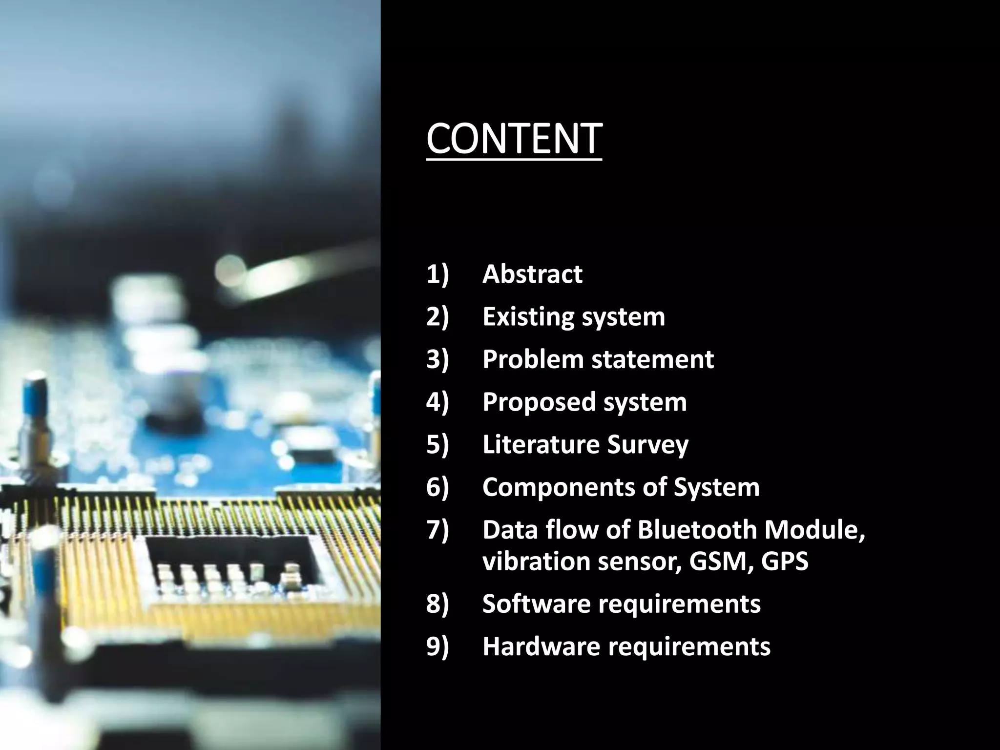
Components:
The following components are utilized in this project.
Hardware Components
ESP32 Microcontroller
GPS Module (NEO-6M)
Vibration Sensor
Relay Module
DC Motor & Motor Driver
OLED Display
Buzzer
Power Supply/Battery
Software Components
Arduino IDE
ESP32 Board Package
Blynk IoT Platform
ThingSpeak Cloud
GPS & Sensor Libraries

Slide 6
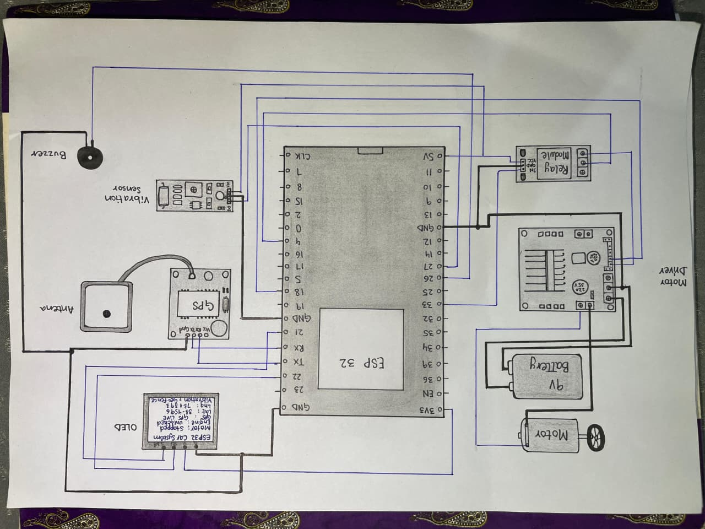
Circuit Diagram:

Slide 7




Connectivity & Communication Protocols
Seamless communication is essential for an effective IoT system. The ESP32 uses Wi-Fi to connect to the internet, allowing user control through the Blynk application and real-time data logging on ThingSpeak.
Wi-Fi Connectivity
Blynk Cloud
Connects the ESP32 to the internet for cloud services and remote access.
Facilitates two-way communication between the user's phone and the vehicle.
ThingSpeak API
Used to securely transmit and store GPS data, accessible for trends and history.

Slide 8

Motor Control & Safety Mechanisms
The system offers precise control over the vehicle's motor and incorporates critical safety features like an engine lock. This ensures that unauthorized movement is prevented, enhancing overall vehicle security.
Motor Direction Control
Allows the user to remotely control the motor's forward and backward movement via the Blynk application.
Forward Drive
Backward Drive
Engine Lock Feature
A relay-controlled mechanism that can remotely disable the motor, preventing unauthorized operation.

Slide 9

Real-time Location Tracking with GPS
The TinyGPSPlus library provides accurate and reliable location data. This is crucial for monitoring the vehicle's position and implementing location-based security features.
1
2
High Precision
Offline Tracking
Utilizes GPS satellites for precise latitude and longitude coordinates.
Maintains the last known location even when GPS signals are temporarily unavailable (e.g., indoors).
3
Serial Communication
Dedicated hardware serial port (GPSSerial) ensures robust data reception from the GPS module.

Slide 10
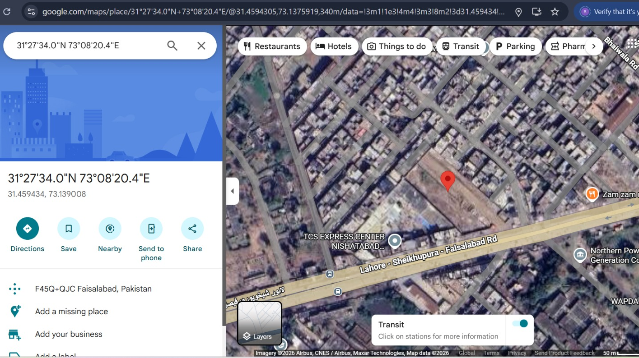

Slide 11

Geo-fencing: Virtual Boundary Security
A critical security feature, geo-fencing creates a virtual boundary around the vehicle's designated area. If the vehicle moves outside this pre-defined radius, an immediate alert is triggered.
Configurable Radius
Real-time Monitoring
The geo-fence can be set to any desired radius in meters.
Continuously compares current GPS coordinates against the geo-fence.
Instant Alerts
Triggers a buzzer and sends a Blynk notification upon breach.

Slide 12

Vibration Detection & Anti-Theft Alarm
A vibration sensor provides an early warning system against tampering or theft. When armed, any significant vibration detected will activate an audible alarm and send an alert to the user.
Arm/Disarm System
Toggle security status via Blynk or serial commands.
Detect Vibration
Monitors the vehicle for unauthorized movement or impact.
Trigger Alarm
Activates a loud buzzer and sends mobile alerts.

Slide 13
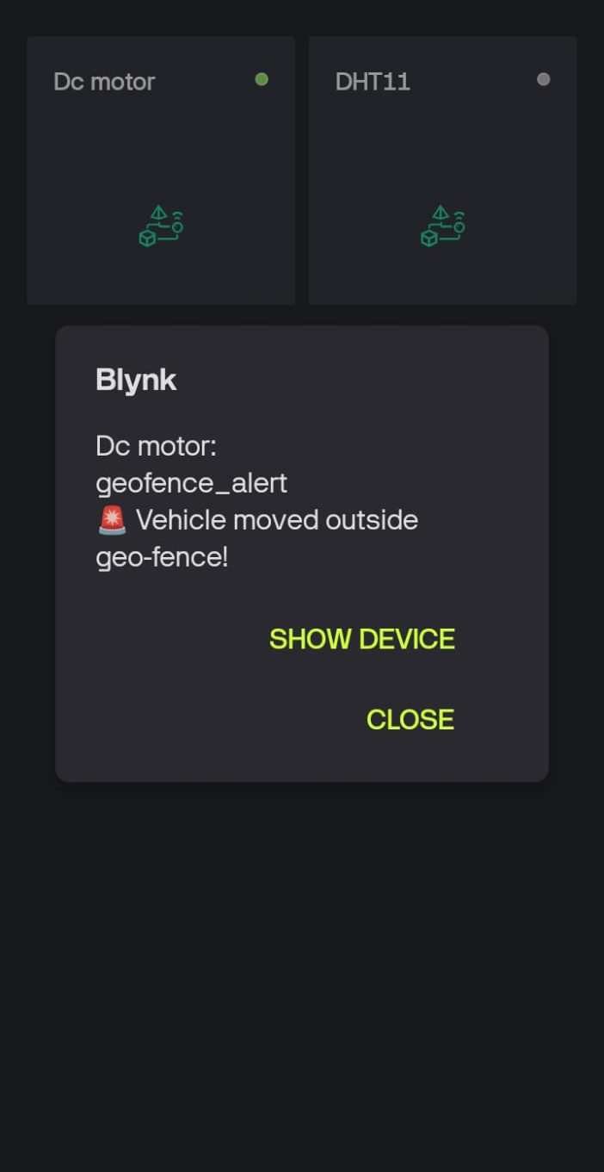
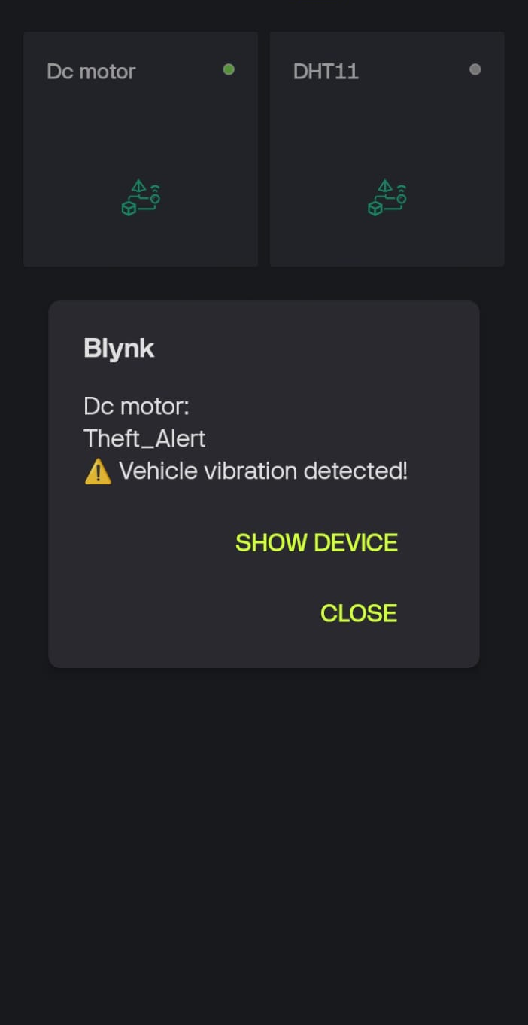
Screenshots of alert notifications

Slide 14
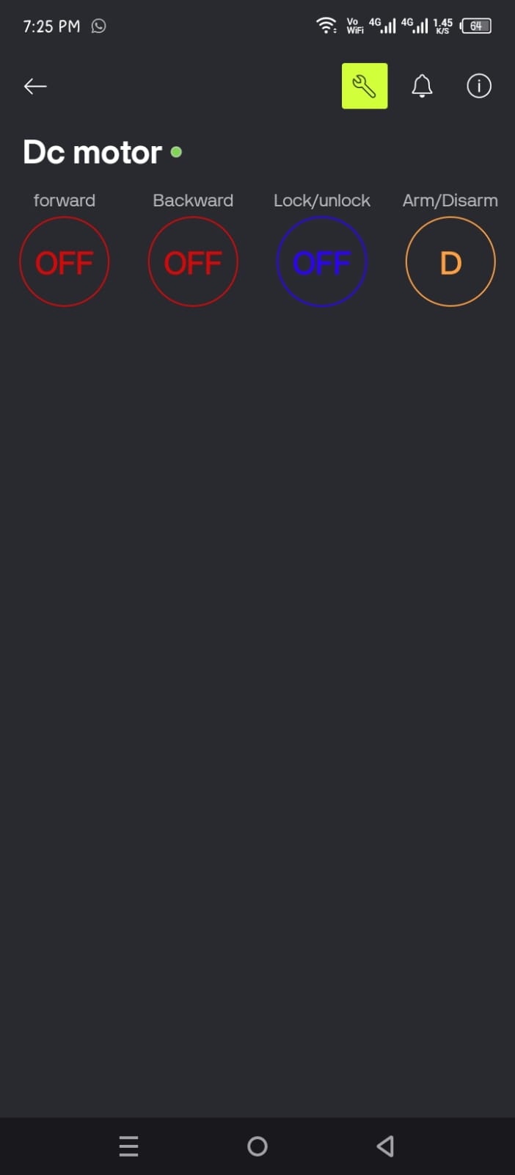
Blynk Integration:
Four buttons have been added to the Blynk application:
Forward Button
For moving the motor forward.
Backward Button
For reversing the motor.
Engine Lock Button
Utilized for locking and unlocking the engine.
Arm/Disarm Button
This button activates or deactivates the system. When the system is armed, and the car is lifted or leaves a specific area, a notification alert will be sent to Blynk.

Slide 15
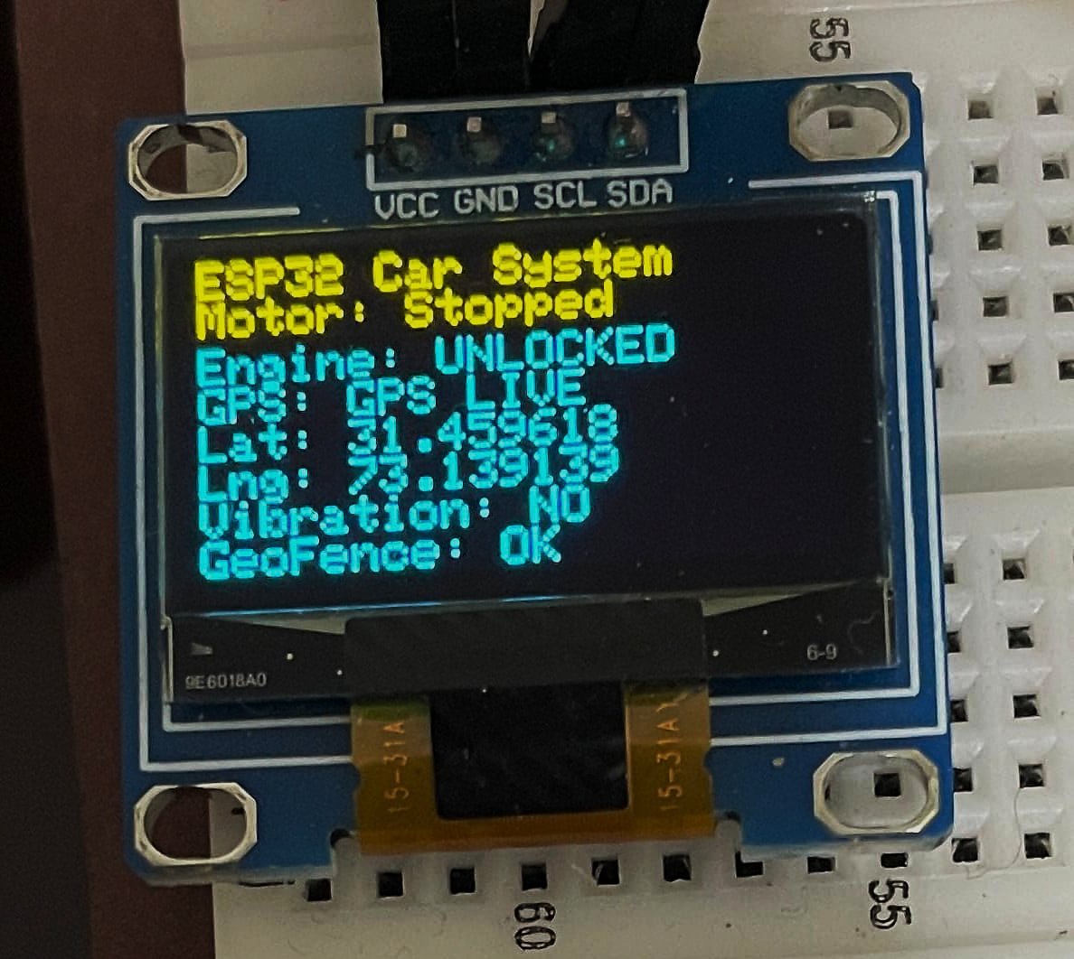
Visual Feedback with OLED Display
A compact OLED display provides immediate, on-device status updates, allowing for quick glances at critical information without needing the Blynk app.
Motor Status: Clearly indicates whether the motor is stopped, moving forward, or backward.
Engine Lock Status: Shows if the engine is "LOCKED" or "UNLOCKED."
GPS Information: Displays current GPS mode (LIVE, LAST, NO GPS) and coordinates.
Security Alerts: Indicates vibration detection and geo-fence breach status.

Slide 16
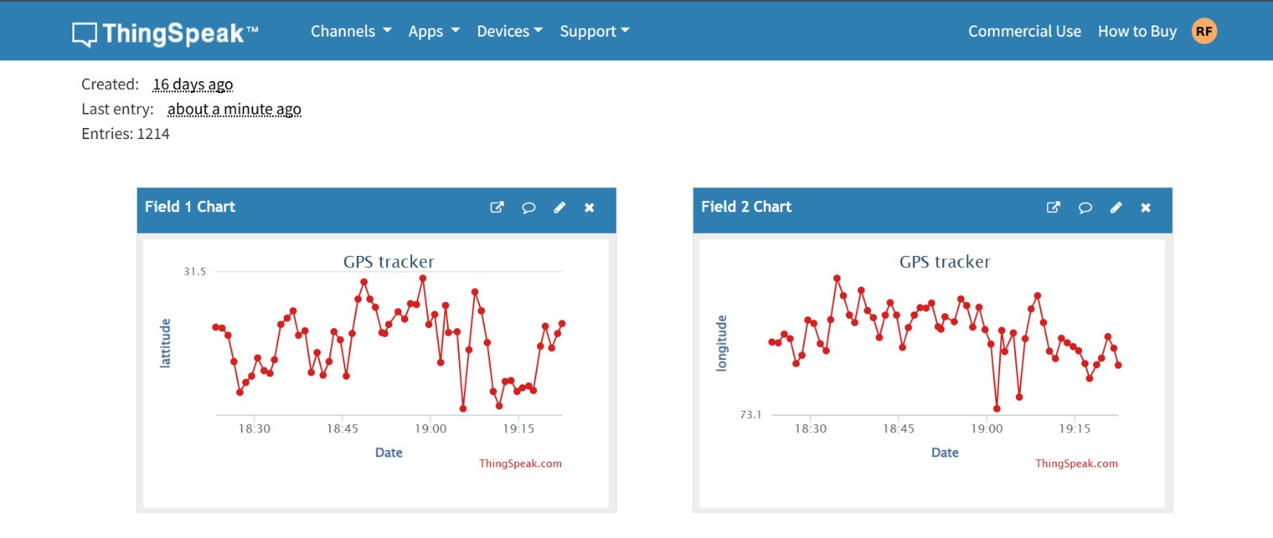
Data Logging & Analytics with ThingSpeak
ThingSpeak serves as a powerful cloud platform for logging and visualizing critical vehicle data. This allows for historical analysis of location patterns and system events.
Latitude
Longitude
GPS coordinates (latitude and longitude) are periodically sent to ThingSpeak, providing a continuous record of the vehicle's movement. This data can be used to track routes, identify unauthorized trips, and analyze usage patterns.

Slide 17






Future Enhancements & Potential
This robust foundation opens doors for numerous future expansions, transforming a security system into a comprehensive smart vehicle management platform.
Battery Monitoring
Temperature Sensors
Integrate battery voltage sensors for low-power alerts.
Monitor cabin or engine temperature for safety.
Route Optimization
Fuel Level Sensor
Use GPS data for efficient route planning and navigation.
Track fuel consumption and receive refill reminders.
Voice Control
Live Video Feed
Implement voice commands for hands-free operation.
Add a camera module for real-time visual surveillance.

Slide 18
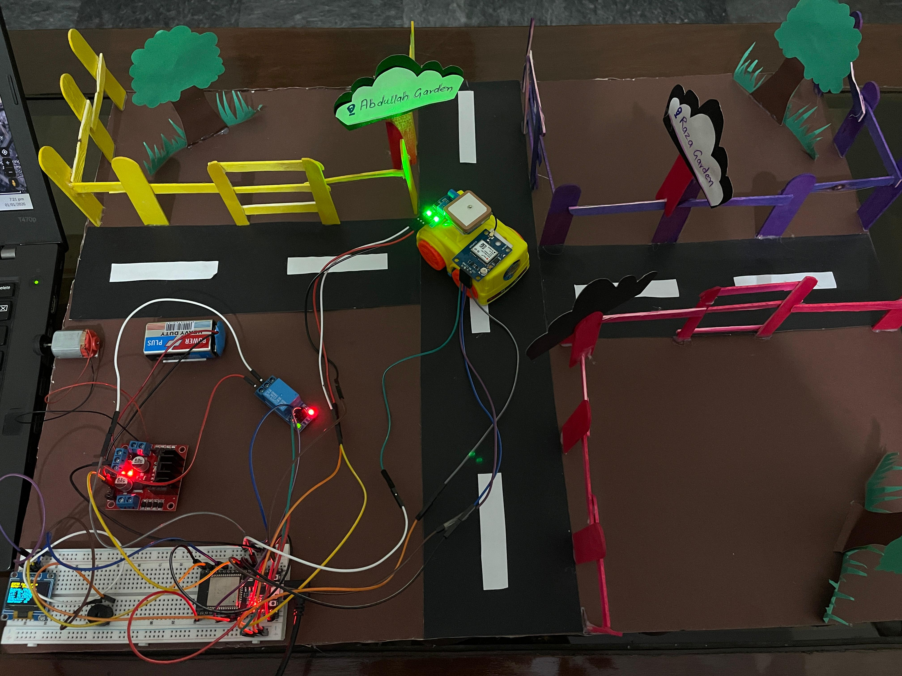
Project Hardware
This IoT-based smart car tracking and anti-theft system successfully provides real-time monitoring, remote engine control, and enhanced theft protection. By integrating ESP32, GPS tracking, vibration detection, and cloud platforms such as Blynk and ThingSpeak, the system ensures reliable performance and user-friendly operation. This project demonstrates an effective and scalable solution for modern vehicle security applications.

